Slide 1
The 21st Of December Thursday
Hello, friends!

Slide 2
Modern Technologies

Slide 3
Vocabulary: Items
a personal computer
a smartphone
a laptop
a flash drive
a game console
earphones
a tablet
a speaker
a webcam
a keyboard
a mouse
a charger

Slide 4
Questions
1. What gadgets do you have?
I have….
2. What gadget do you want for your birthday?
I would like to have….

Slide 5
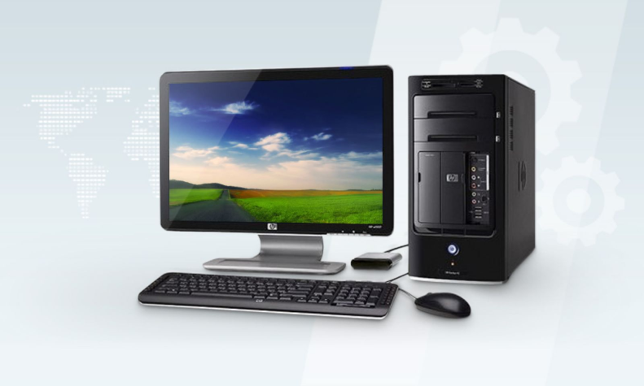
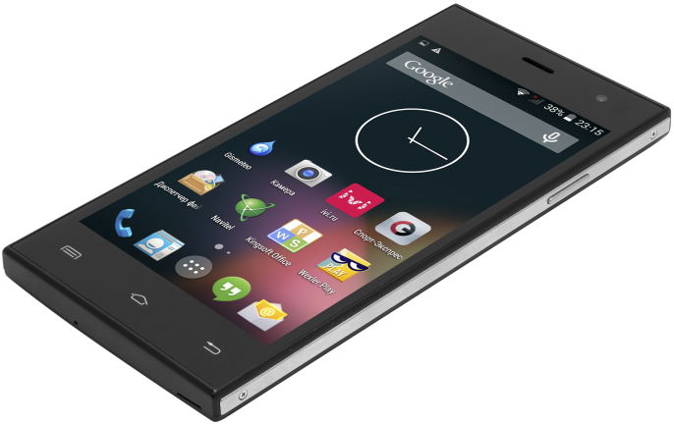
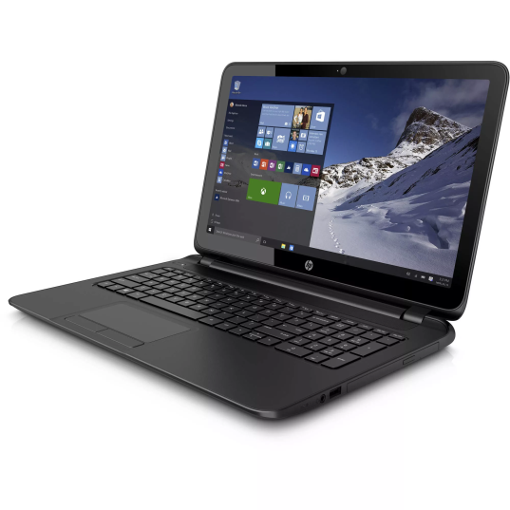
Gadgets
A personal computer
A smartphone
A mouse
A keyboard
A laptop

Slide 6
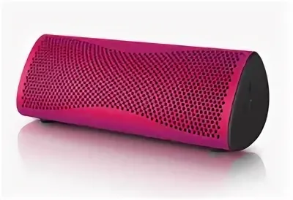
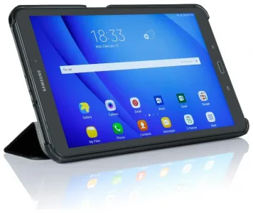
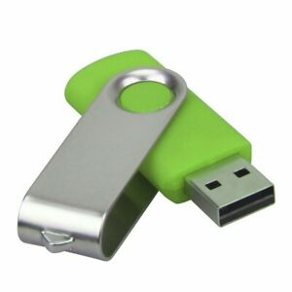
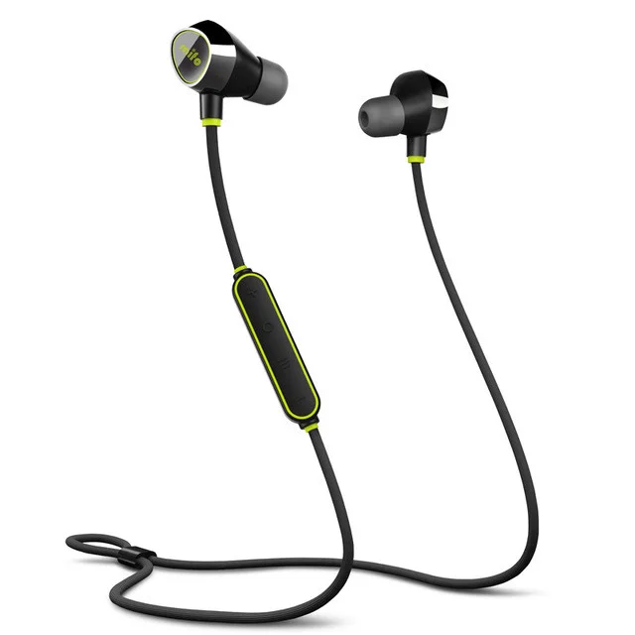
Gadgets
A tablet
A speaker
A flash drive
Earphones

Slide 7
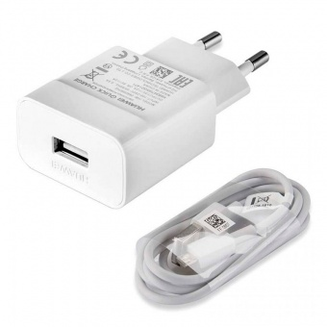
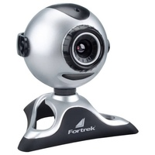
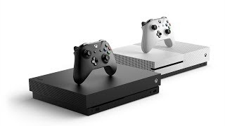
Gadgets
A webcam
A charger
A game console

Slide 8
Activities: match to make collocations
Listen
Send
Surf
Take
Watch
Play
Read
Talk to
Type
Store
Post
Recharge
e-mails
videos
e-books
games
text messages
pictures
family and friends
to music
music files
the Net
the battery
my comment

Slide 9
Make sentences about yourself using the collocations
e.g. I use my tablet to listen to music.
I use my _____ to ______.
I use my _____ to ______.
I use my _____ to ______.
I use my _____ to ______.
I use my _____ to ______.

Slide 10
Will vs Be going to
Will:
1. Предсказания, особенно после I (don’t) think….
I think she’ll pass her exams.
2. Предложения и обещания
Oh, I promise I will wash the dishes!
3. Мгновенные решения
It’s cold here. I’ll close the window.
Be going to:
4. Предсказания на основании того, что мы видим
Watch out! You are going to fall!
5. Намерения. I’m going to take some pictures of you.

Slide 11
Probably and Definitely
We can use probably (возможно) and definitely (обязательно) to talk about how certain our intentions are
I’m definitely going to buy a new tablet.
We’ll probably make a new video today.
I probably won’t go online tonight.
Write two things that you’re definitely going to do this evening.
Write two things that you probably won’t do in the summer holidays.
Write two things you definitely do after you leave school.

Slide 12
Complete the sentences with the correct form of the verbs
1.It is very cold here. I …….(close) the window.
a) close b) am going to close c) am closing
2.Kate likes singing. She ….. a singer in the future.
a) is b) will be c) is going to be
3. They …….. their grandmother next Sunday.
a) visit b) are visiting c) are going to visit

Slide 13
Listening
Ex.8 p.49

Slide 14
Check
1. headphones
2. speaker
3. 2000
4. J199
5. 0800 755 844

Slide 15
The project

Slide 16
Hometask
Ex. 5 p. 49 in writing

Slide 17
Complete…
I learnt new words
I knew about modern technologies
I read about future forms
I remembered how to say about future plans

Slide 18
Did you like our lesson?
Colour your sticker!

