Slide 1
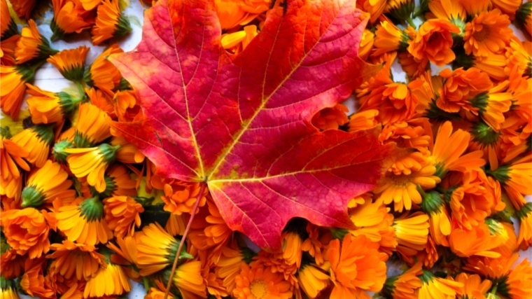
My holidays

Slide 2
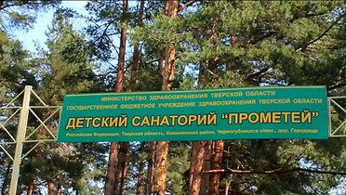
During the autumn holidays I was resting in the resort «Prometheus». I went there with my class.

Slide 3
We were assigned procedures such as: halotherapy, oxygen cocktails. Halotherapy was performed in a salt room. There we breathed sea salt and watched films, cartoons. Oxygen cocktails contained useful herbs.

Slide 4
In the resort we celebrated the holiday of Halloween. We painted faces and frightened each other.

Slide 5
The resort held fun contests almost every day. I liked my holidays very much.

