Slide 1
Essay Scotland and its places of interest
Выполнила: Сурикова Е. В
10 А класс
МОУСОШ № 40
Научный руководитель:
Прач О.П.

Slide 2
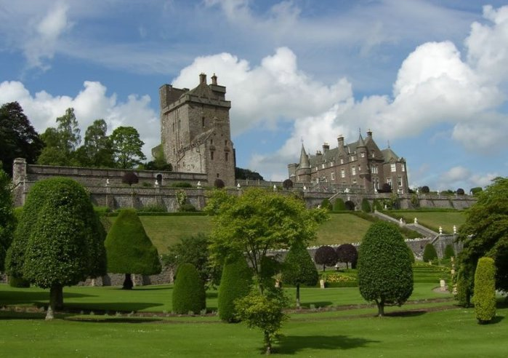
The aim of my work
I was seized with an idea of studying more about Scottish places of interest and that is why I decided to take this topic for my work. I am not sure that I will be able to tell everything that I found out about this country and its people. But the aim of this work is describing all unforgettable places of interest that impressed me most of all.

Slide 3
Few words about Scotland
Scotland is a country that is part of the United Kingdom. Occupying the northern third of the island of Great Britain, it shares a border with England to the south and is bounded by the North Sea to the east, the Atlantic Ocean to the north and west, and the North Channel and Irish Sea to the southwest. It has your own symbols, national music and a flag.

Slide 4
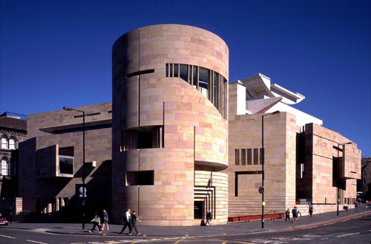
Museums and Galleries
All of the larger towns and cities in Scotland have their own collections in civic museums and gallaries. Aberdeen has a notable water-colour emphasis, Kirckaldy is the place to see Scottish artists such as MacTaggart,Paisley is strong on the story of the famous Paisley pattern shawl. Stirling even displays Scotland’s earliest football!

Slide 5
In addition, Scotland also has plenty of smaller community museums that usually make a good starting point for discovering an area’s heritage. There are also plenty of more specialist museums, with themes that include costume, rural life, Roman times, Highland life, fishing heritage and even the story of Scotland’s lighthouses. All of the larger museums have café and shop facilities.

Slide 6
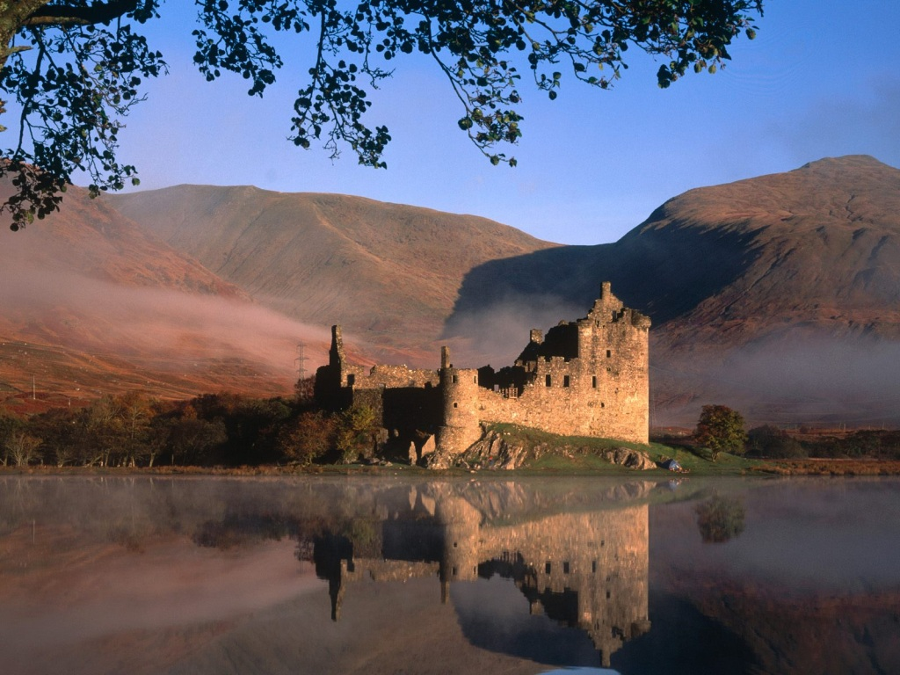
Castles
Sheer variety is the key to Scottish castles: from uncompromising square keeps and tower-houses in the Scottish Borders, such as Smailholm Tower, to romantic restored Highland fortresses, like the iconic Eilean Donan Castle or impressive Duart Castle on Mull.

Slide 7
Gardens
Scotland has a great tradition of gardening and horticulture – partly through the work of generations of Scottish plant-hunters, such as David Douglas and George Forrest, who went abroad to bring back new species and give their names to many familiar garden plants of today.

Slide 8
Abbeys, Churches and Cathedrals
The Reformation in Scotland had great implications for Scotland’s churches and abbeys, with much damage wrought on fixtures and decorations. The four great Border abbeys were all reduced to various states of ruin. Scotland’s best preserved abbey is Inchcolm, its island position helping in its preservation. Likewise, the story of cathedrals such as at St Andrews (once the largest in Scotland) and Elgin ‘The Lantern of the North’ is one that ends with their use as a source of ready-dressed stone for local buildings. However, others, such as Dunkeld and Dunblane, have been at least restored in part to serve today as parish churches, while other religious centres, such as Rosslyn Chapel, continue to fascinate visitors

Slide 9
Monuments
Scotland built heritage is especially rich in early monuments, with its variety of chambered cairns, standing stones, later souterrains and hillforts, along with the evidence of the Romans at places like the Antonine Wall and its associated sites. Circular-walled brochs are a uniquely Scottish category and a speciality of the north. Later still are the mysterious Pictish carved standing stones.

Slide 10
Beaches
The more rugged north and west coasts likewise have beautiful sands, often as smaller coves set amongst magnificent cliff scenery, while the dazzling white beaches of the Hebrides – look for the Gaelic word ‘traigh’ on maps – are an essential element of the island experience and a real highlight of a visit to, for example, Harris or Islay. The Big Strand on Islay, for example, is at least 7.5 miles (12 km) long.

Slide 11
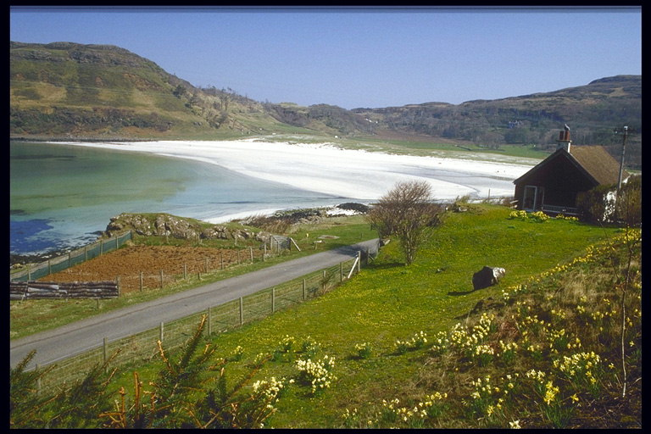
Some beaches have an association with a particular leisure pursuit – Thurso (Dunnet Bay) for surfing, for instance; beaches on Tiree for wind surfing; St Andrews for kite-surfing – but all of these are practiced at a variety of Scottish beaches.

Slide 12
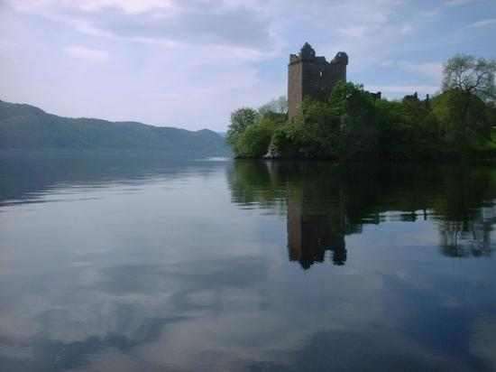
Loch Ness Lake
The Loch Ness Monster (Scottish Gaelic: Niseag) is a cryptic that is reputed to inhabit Loch Ness in the Scottish Highlands. It is similar to other supposed lake monsters in Scotland and elsewhere, though its description varies from one account to the next.

Slide 13
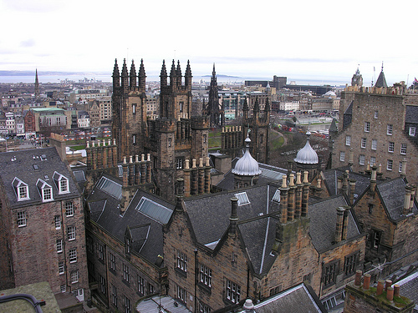
Conclusion
So, Scotland is a country of great variety with its own unique character and strong tradition. Its cities offer a mixture of designer lifestyle and old traditions, while the countryside ranges from Britain’s highest mountains and waterfalls to the most stunning gorges and glens.

Slide 14
Thank you for your attention

