Slide 1
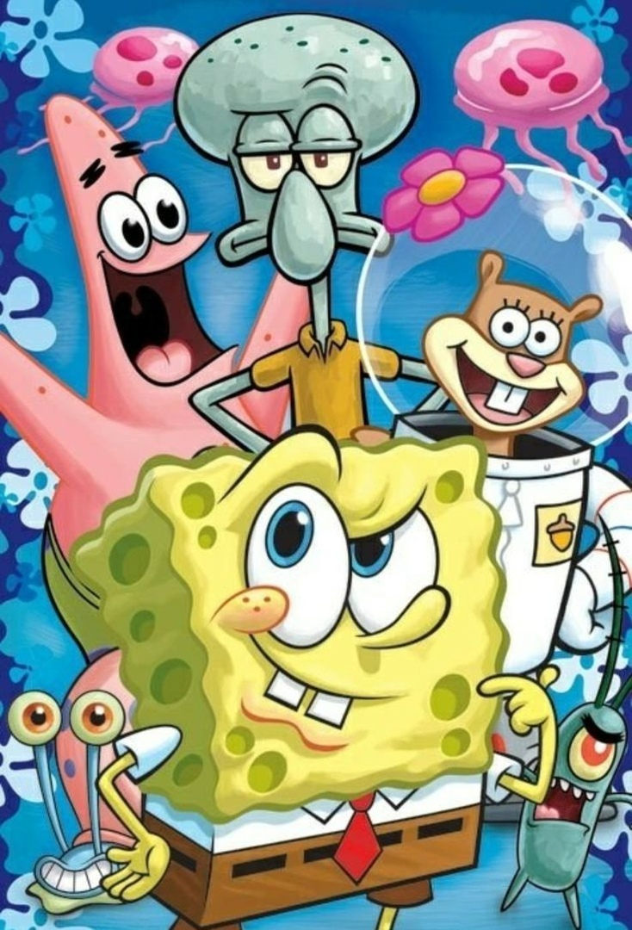
Do you like to watch cartoons?

Slide 2
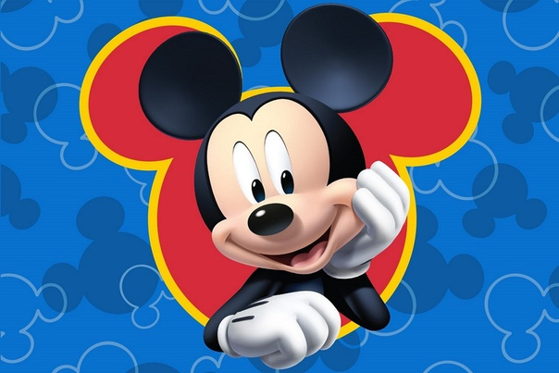
Do you like to watch cartoons?

Slide 3
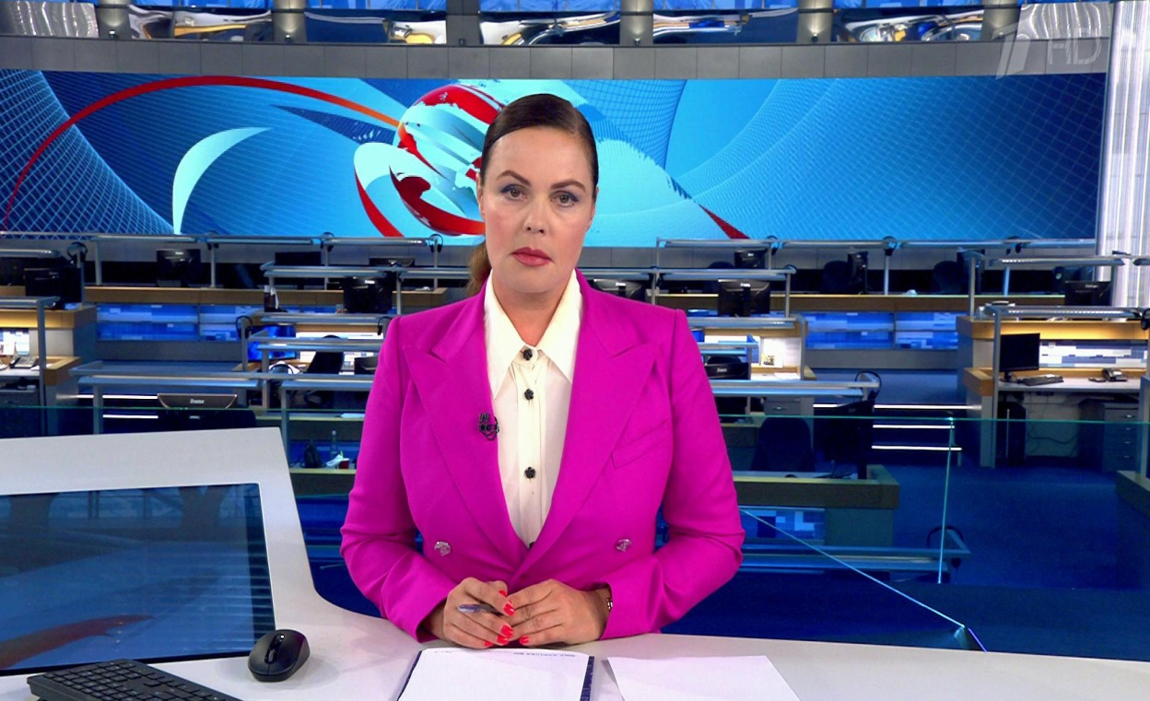
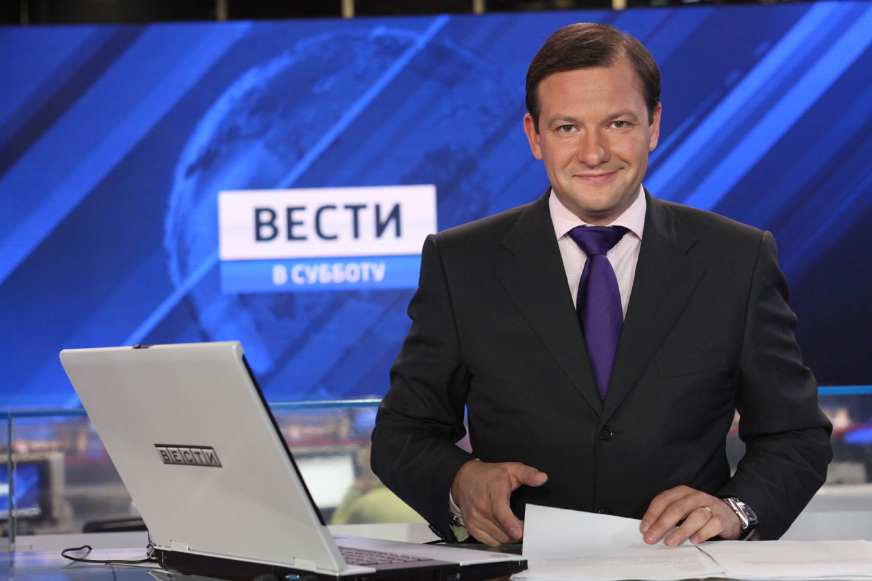
Do you like to watch the news?

Slide 4
Do you like to watch adventure films?

Slide 5
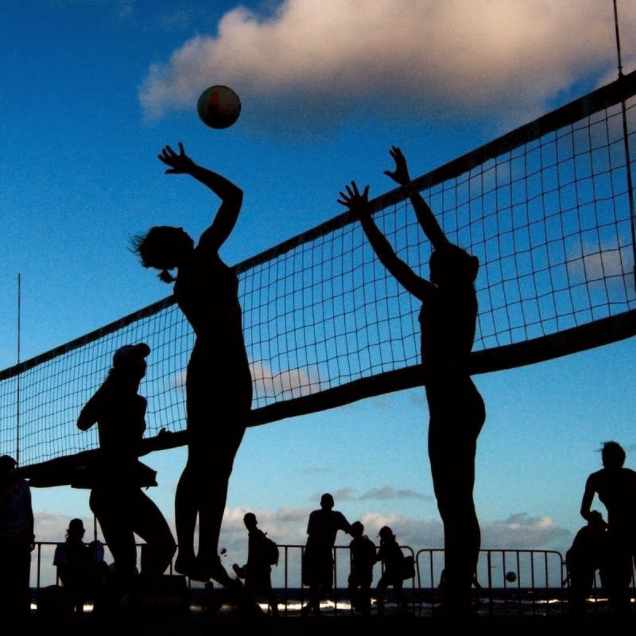
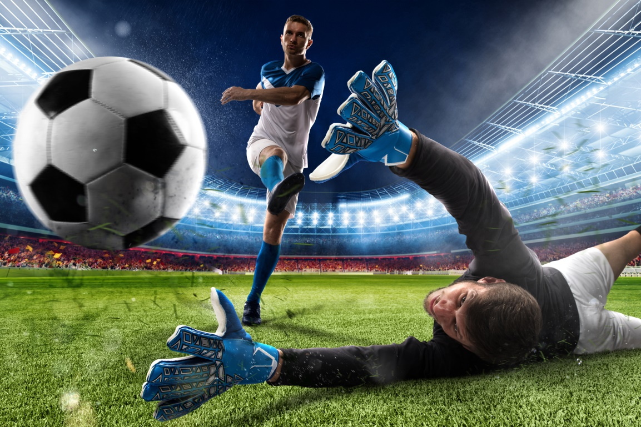
Do you like to watch Volleyball match? Do you like to watch football match?

Slide 6
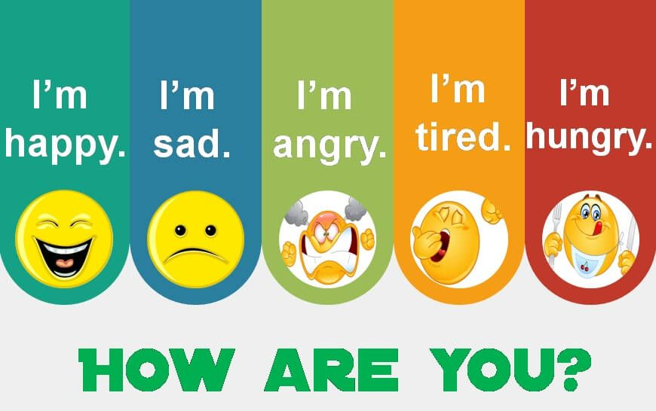
Happy cold hot frightened thirsty sick hungry

