Slide 1
On the menu

Slide 2
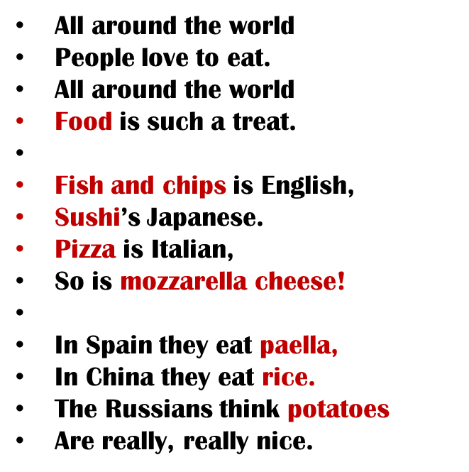
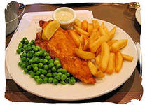
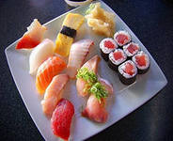
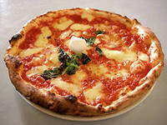
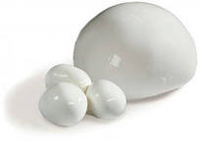
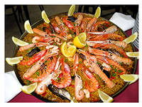
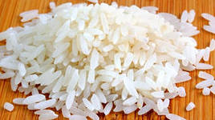
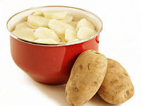
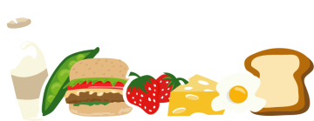
ALL AROUND THE WORLD

Slide 3
READ THE FIRST TWO LINES OF THE DIALOGUE AND ANSWER MY QUESTIONS
1/ Where are George and Sheila?
2/ How many people are talking?
3/ What are they called?
LISTEN TO THE DIALOGUE and LOOK INTO THE TEXT AT THE SAME TIME.
What does George choose to eat?
What about Sheila?

Slide 4
READ THE STATEMENTS AND MARK THEM AS TRUE/FALSE/NOT SAID
1/GEORGE INVITED SHEILA TO LUNCH
TRUE.
2/ GEORGE SAYS THAT HE IS VERY HUNGRY.
FALSE. SHEILA SAYS THAT SHE IS HUNGRY.
3/ SHEILA NEVER EATS MEAT.
FALSE. SHE ENJOYS EATING MEAT. SHE ISN’T EATING MEAT TODAY.
4/ GEORGE SAYS THAT HE IS ON A DIET.
FALSE. SHEILA SAYS THAT SHE IS ON A DIET.
5/ GEORGE DOESN’T LIKE THE SIRLOIN STEAK.
NOT SAID. WE HAVE NO INFORMATION ABOUT THAT.

Slide 5
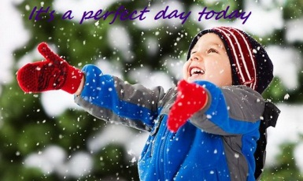
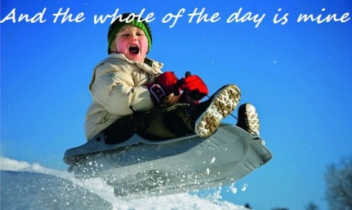
Perfect Day
It`s a perfect day today
Nothing`s going wrong
I really hope it stays this way
Perfect all day long
It`s Saturday and there`s no school
Saturdays are really cool
I can relax and meet my friends
I hope today never ends
***
It`s a perfect day, so I can`t loose
I can do whatever I choose
I look good and I feel fine
And the whole of the day is mine

Slide 6
Когда употребляется?
Present Simple
Действие происходит часто, постоянно, регулярно
Указатели времени: Every day, always, usually, sometimes, often, seldom, rare
Present Continuous
Действие происходит сейчас, в данный момент
Указатели времени:
Now, at the moment

Slide 7
Как образуется?
Present Simple Present Continuous
Утвердительное предложение
I, you, we, they
I
V
am
V ing
He, she, it
You, we, they
Vs(es)
are
He, she, it
is

Slide 8
Как образуется?
Present Simple Present Continuous Вопросительное предложение
Do
I, you, we, they
Am
I
V?
V ing?
you, we, they
Are
Does
he, she, it
he, she, it
Is

Slide 9
1 ) Are you enjoying your meal? – Yes, thanks. It’s lovely.
2) Jack always has a party on his birthday.
3) I don`t work on Sundays. It’s my day off.
4) «What are you reading?» – «It’s the novel by Mark Twain.»
5) Mary isn’t here today. She is spending the day with her family.
6) All my friends come to my birthday party every year.
7) We usually grow vegetables in our garden, but this year we aren`t growing any.
8) Ted is in Rome now. He is staying at the Hilton Hotel. He usually stays at this hotel when he’s in Rome.
9) I`m cooking with my friend Mary at the moment.
10) We always buy fresh fruit from the market.

Slide 10
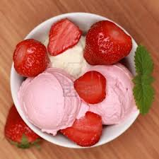
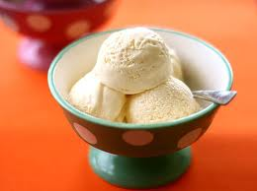
CHOCOLATE /STRAWBERRY/VANILLA ICE CREAM

Slide 11
MILK SHAKES

Slide 12
TEA

Slide 13
CAKE

Slide 14
Pumpkin

Slide 15
Food
What is your favourite food?
I like ____________. Yummy!
What don`t you like?
I don`t like____________. Yuk!

Slide 16
Homework
SB p. 89 ex. 7 (written)

