Slide 1


Present Simple
n
i
E
l
g
s
h

Slide 2
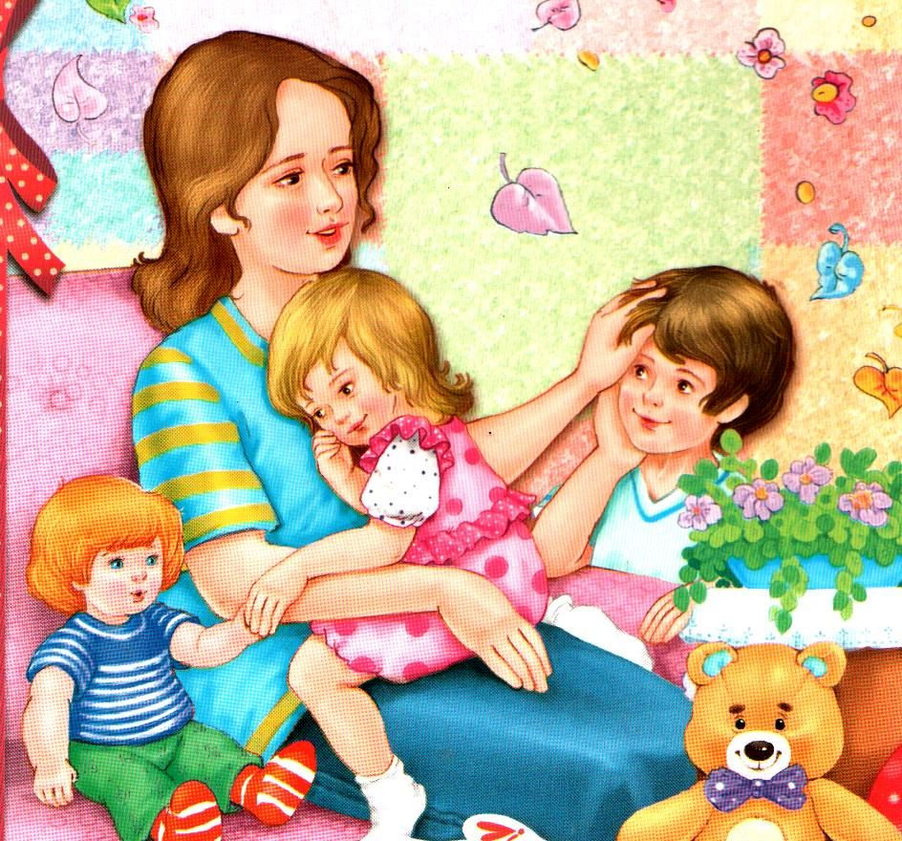
Sometimes Mum says:
«Don’t do this!»
Sometimes Mum says:
«Don’t do that!»
She still loves me, that I know.
Why?
Because she tells me so.
Sometimes Mum says:
«Let’s do this!»
Sometimes Mum says:
«Kiss, kiss, kiss!»

Slide 3

Случаи употребления
Повторяющиеся действия
We drink coffee in the morning.
He gets up at 7 o’clock every day.
Привычные действия
We live in Russia.
Peter swims well.
  Выражение общеизвестных фактов
Paris is the capital of France.
Birds fly.

Slide 4
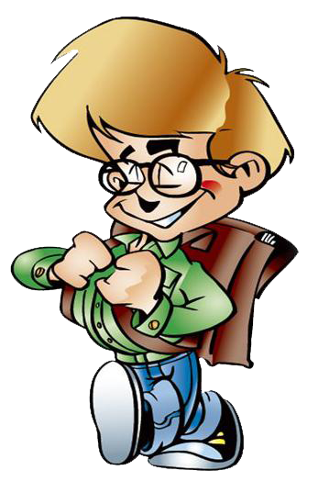



Формула
Present Simple Tense
I
We
You
They
He
Se
It

Slide 5




Present Simple Tense

Slide 6




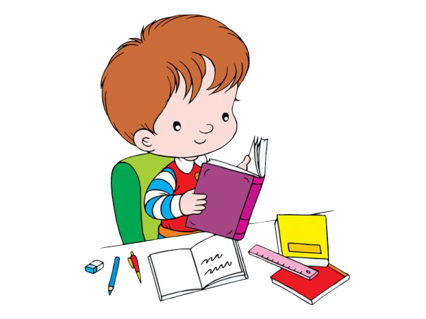


Present Simple Tense

Slide 7




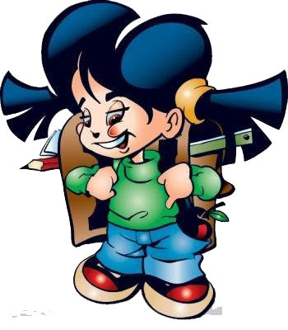


Present Simple Tense

Slide 8
Present Simple Tense
p.37 ex.4
1 I go – she
2 I sleep – he
3 I study – she
4 I play – he
5 I catch - she
6 I fix – he
7 I wash – she
8 I cry – he

Slide 9



Slide 10
Наречия частотности.
Adverbs of Frequency.
В предложениях в Present Simple мы часто употребляем слова, которые указывают на то, как часто происходит то или иное действие.
always – всегда 100%
usually – обычно 70%
often – часто 40%
sometimes – иногда 20%
rarely – редко 10%
never – никогда 0%

Slide 11


Where do we put the adverbs of frequency?
An adverb of frequency goes before a main verb.
I often go to the cinema.
An adverb of frequency goes after to be
They are never late.

Slide 12



We can use usually and sometimes
beginning
middle end
He sometimes comes here.
They don’t usually do that.
We use every day (week, month, year) at the end of a sentence.
She brushes her teeth every day.

Slide 13
Keys:
1. I often play tennis on Sundays.
2. The weather is always bad in November.
3. Sometimes they go swimming in the lake. (They sometimes go swimming in the lake) (They go swimming in the lake sometimes).
4. Peggy is usually late. (Usually Peggy is late) (Peggy is late usually).
5. John plays the piano every week.

Slide 14
