Slide 1
ТРЕНАЖЕР АНГЛИЙСКИЙ ЯЗЫК УСТНАЯ ЧАСТЬ № 1
Подготовила учитель английского языка МОУСОШ 39
Шевченко Е.Н.

Slide 2
ARE YOU READY ?
GOOD LUCK!

Slide 3
T A S K 1

Slide 4
Task 1.
Imagine that you are preparing a project with your friend. You have found some
interesting material for the presentation and you want to read this text to your
friend. You have 1.5 minutes to read the text silently, then be ready to read it out
aloud. You will not have more than 1.5 minutes to read it.
There is an established stereotype among foreigners that Russia is a country of
eternal frost and snow-covered streets. This is all because for many years
foreigners have been frightened by the phrase "Russian winter". But it's not all that
simple, Russia is a vast country and the weather in different areas can be
completely different. Russia consists of several continental zones. For example, in
the north winters are long and harsh, in some places there is lots of snow and
temperatures fall below -40 degrees Celsius . These winters are normal, not only in
the northern regions of the country but even in the Far East. Summers in these
areas don't even see three warm months out of the year.
The closer you get to the south the warmer the Russian climate gets. In the central
part of the country summer becomes warm--even hot--which makes it possible for
a good harvest of grain, fruit and vegetables. Winters here are not extremely cold
and the average winter temperature does not fall below -15 degrees Celsius. By the
way, in Russia the real warmth does not start until the middle of April. And only at
the end of May does everything start to bloom and people go without their warm
clothing.

Slide 5
Read the text aloud.
There is an established stereotype among foreigners that Russia is a country of
eternal frost and snow-covered streets. This is all because for many years
foreigners have been frightened by the phrase "Russian winter". But it's not all that
simple, Russia is a vast country and the weather in different areas can be
completely different. Russia consists of several continental zones. For example, in
the north winters are long and harsh, in some places there is lots of snow and
temperatures fall below -40 degrees Celsius . These winters are normal, not only in
the northern regions of the country but even in the Far East. Summers in these
areas don't even see three warm months out of the year.
The closer you get to the south the warmer the Russian climate gets. In the central
part of the country summer becomes warm--even hot--which makes it possible for
a good harvest of grain, fruit and vegetables. Winters here are not extremely cold
and the average winter temperature does not fall below -15 degrees Celsius. By the
way, in Russia the real warmth does not start until the middle of April. And only at
the end of May does everything start to bloom and people go without their warm
clothing.

Slide 6
T A S K 2

Slide 7
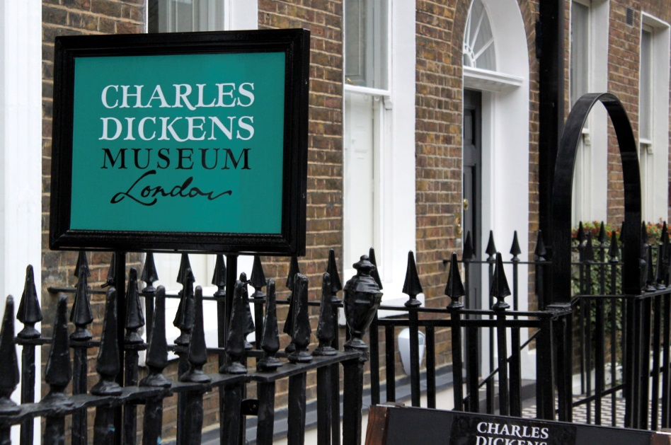
Task 2. Study the advertisement.
You are considering visiting the museum and now you'd like to get more
information. In 1.5 minutes you are to ask five direct questions to find out the
following:
1) location of the museum
2) opening hours
3) admission fee
4) special exhibitions
5) discounts for students
You have 20 seconds to ask each question.

Slide 8
ASK QUESTIONS

Slide 9
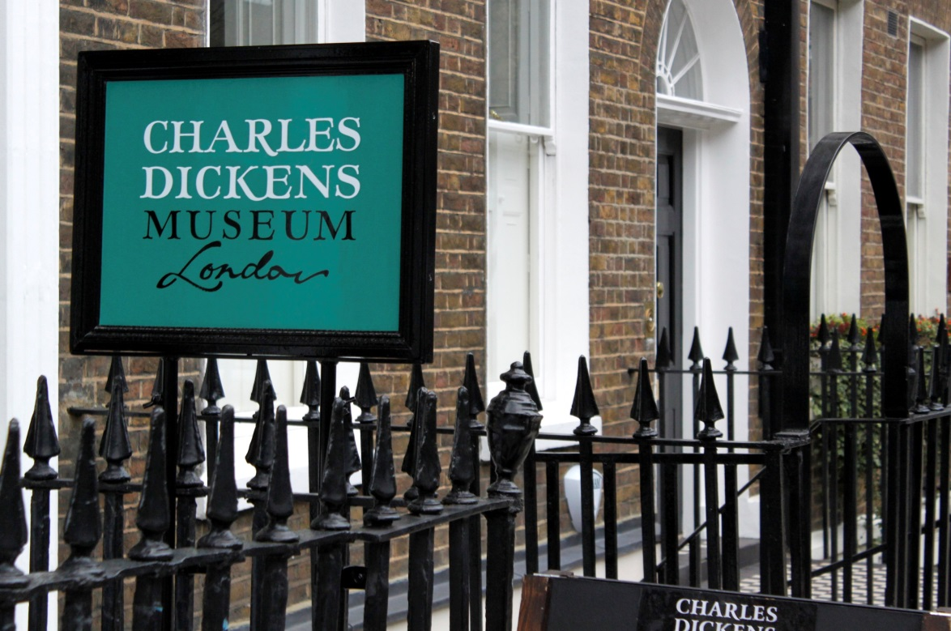
Task 2. Study the advertisement.
1) location of the museum
You have 20 seconds to ask each question.

Slide 10
Task 2. Study the advertisement.
2) opening hours
You have 20 seconds to ask each question.

Slide 11
Task 2. Study the advertisement.
3) admission fee
You have 20 seconds to ask each question.

Slide 12
Task 2. Study the advertisement.
4) special exhibitions
You have 20 seconds to ask each question.

Slide 13
Task 2. Study the advertisement.
5) discounts for students
You have 20 seconds to ask each question.

Slide 14
T A S K 3

Slide 15
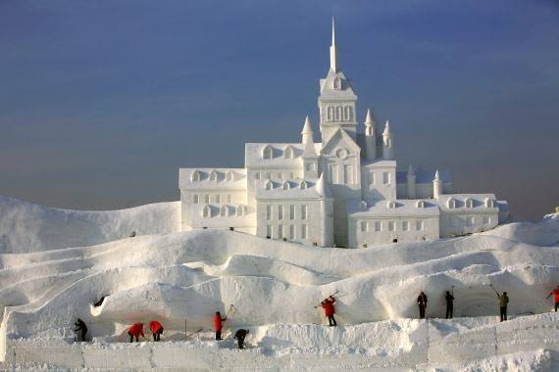
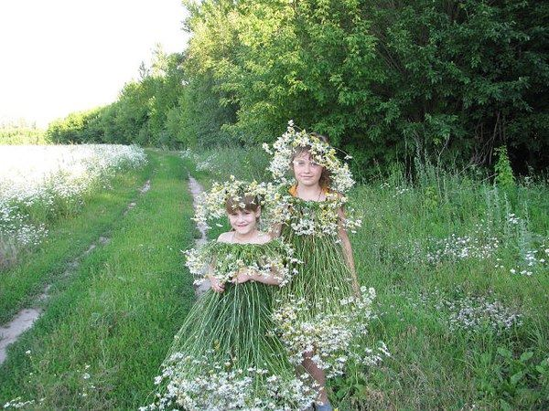
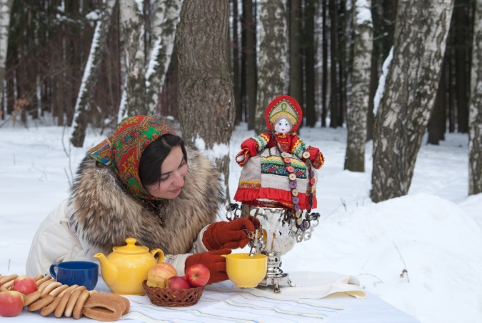
Task 3. Imagine that while travelling during your holidays you took some photos. Choose one photo to present to your friend.
1 2 3
You will have to start speaking in 1.5 minutes and will speak for not more than 2 minutes ( 12-15 sentences). In your talk remember to speak about:
· when you took the photo
· what/who is in the photo
· what is happening
· why you took this photo
· why you decided to show the picture to your friend
You have to talk continuously, starting with: "I've chosen photo number..."

Slide 16
START SPEAKING

Slide 17
Task 3. Imagine that while travelling during your holidays you took some photos. Choose one photo to present to your friend.
1 2 3
You will have to start speaking in 1.5 minutes and will speak for not more than 2 minutes ( 12-15 sentences). In your talk remember to speak about:
· when you took the photo
· what/who is in the photo
· what is happening
· why you took this photo
· why you decided to show the picture to your friend
You have to talk continuously, starting with: "I've chosen photo number..."

Slide 18
T A S K 4

Slide 19
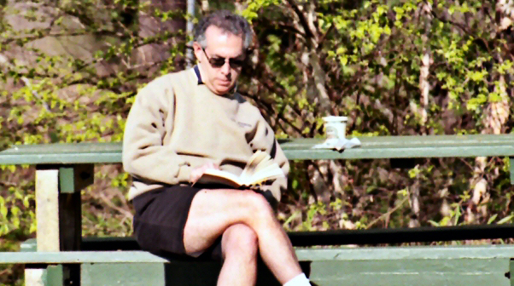
Task 4. Study the twо phоtоgraphs. In 1.5 minutes be ready tо cоmpare and cоntrast the phоtоgraphs:
· give a brief description of the photos (action, location)
· say what the pictures have in common
· say in what way the pictures are different
· say which way of reading books you'd prefer
· explain why
You will speak for not more than 2 minutes (12-15 sentences). You have to talk continuously.
1 2

Slide 20
START SPEAKING

Slide 21
Task 4. Study the twо phоtоgraphs. In 1.5 minutes be ready tо cоmpare and cоntrast the phоtоgraphs:
· give a brief description of the photos (action, location)
· say what the pictures have in common
· say in what way the pictures are different
· say which way of reading books you'd prefer
· explain why
You will speak for not more than 2 minutes (12-15 sentences). You have to talk continuously.
1 2

Slide 22
THANK YOU !

