Slide 1
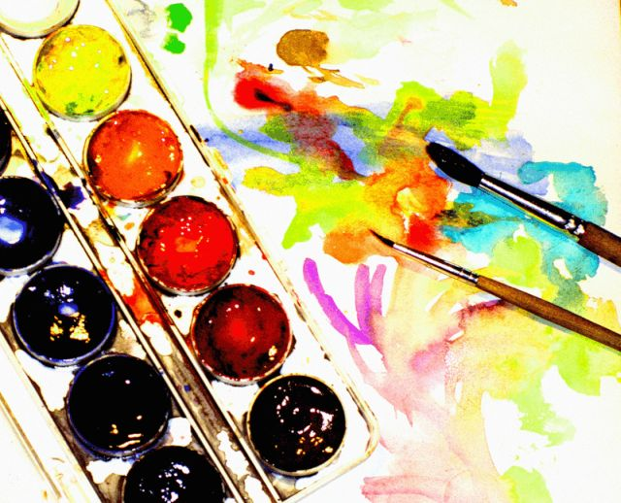
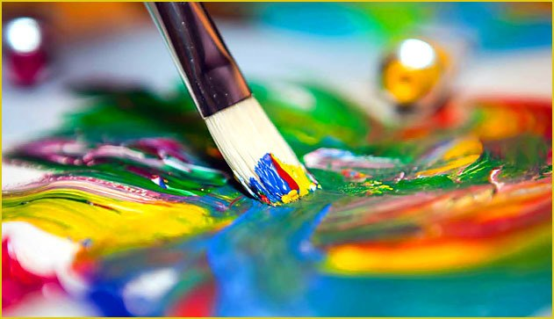
My hobby

Slide 2
MY HOBBY
My hobby is drawing. I started to draw, when I was 2 years old. My first exhibition of drawings was held in a kindergarten. I learned to draw in an art school. Now I'm at the Ultramarine studio. My teacher is Anastasia Nikolaevna Djogan. I like to paint pastels landscapes and still lifes. But I do not have time for my hobby, because I do homework all the time.

Slide 3
