Slide 1
My hobby is...

Slide 2
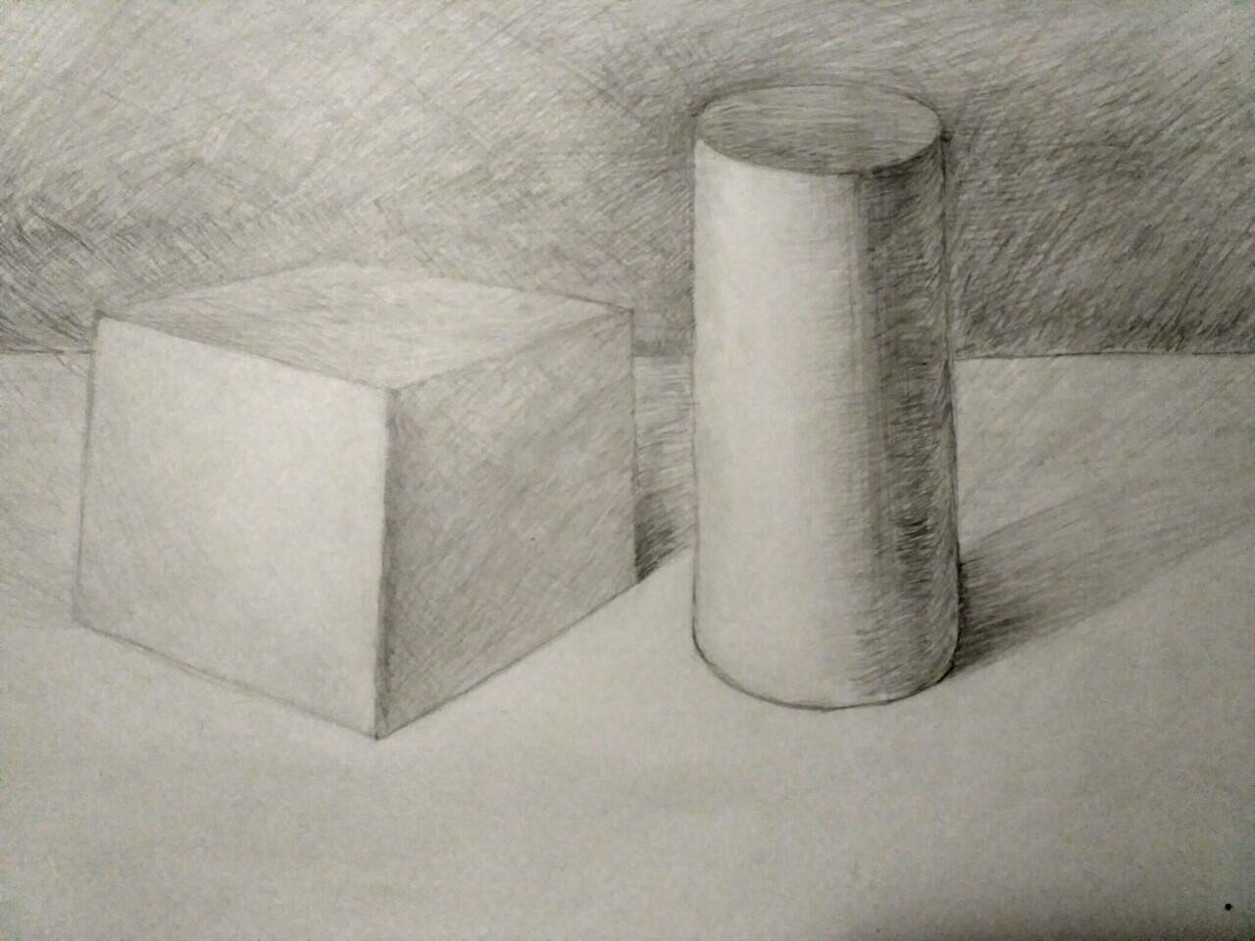
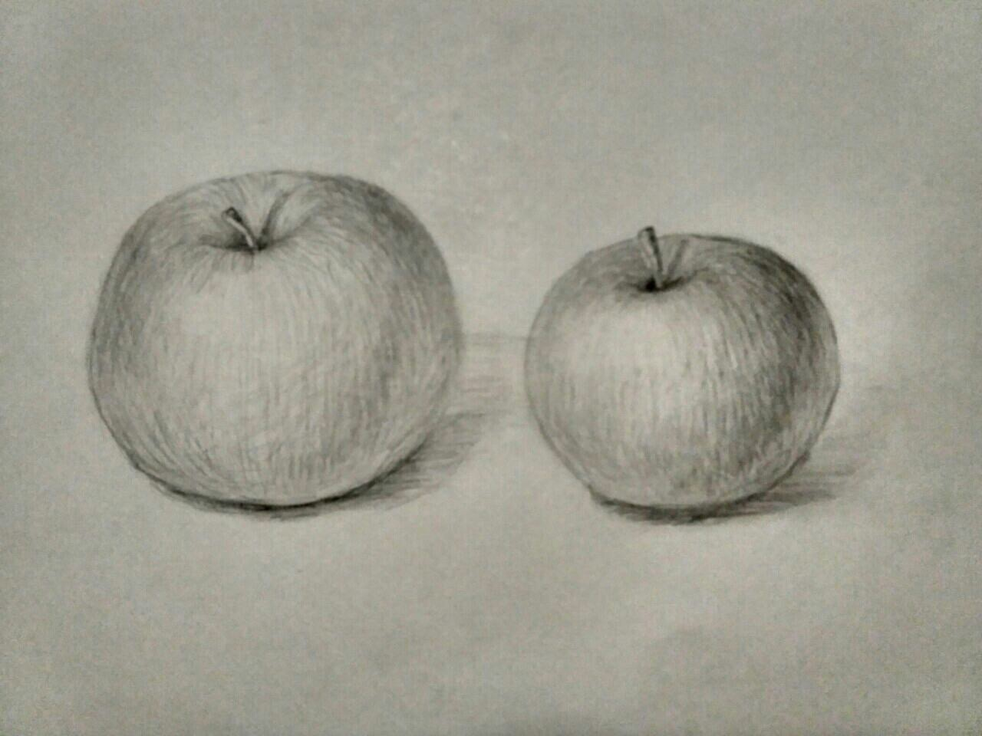
My hobby is drawing.It is an intresting hobby. I make a lot of pictures. I do it not long but I have already learnt to draw a little. I like it very much.

Slide 3
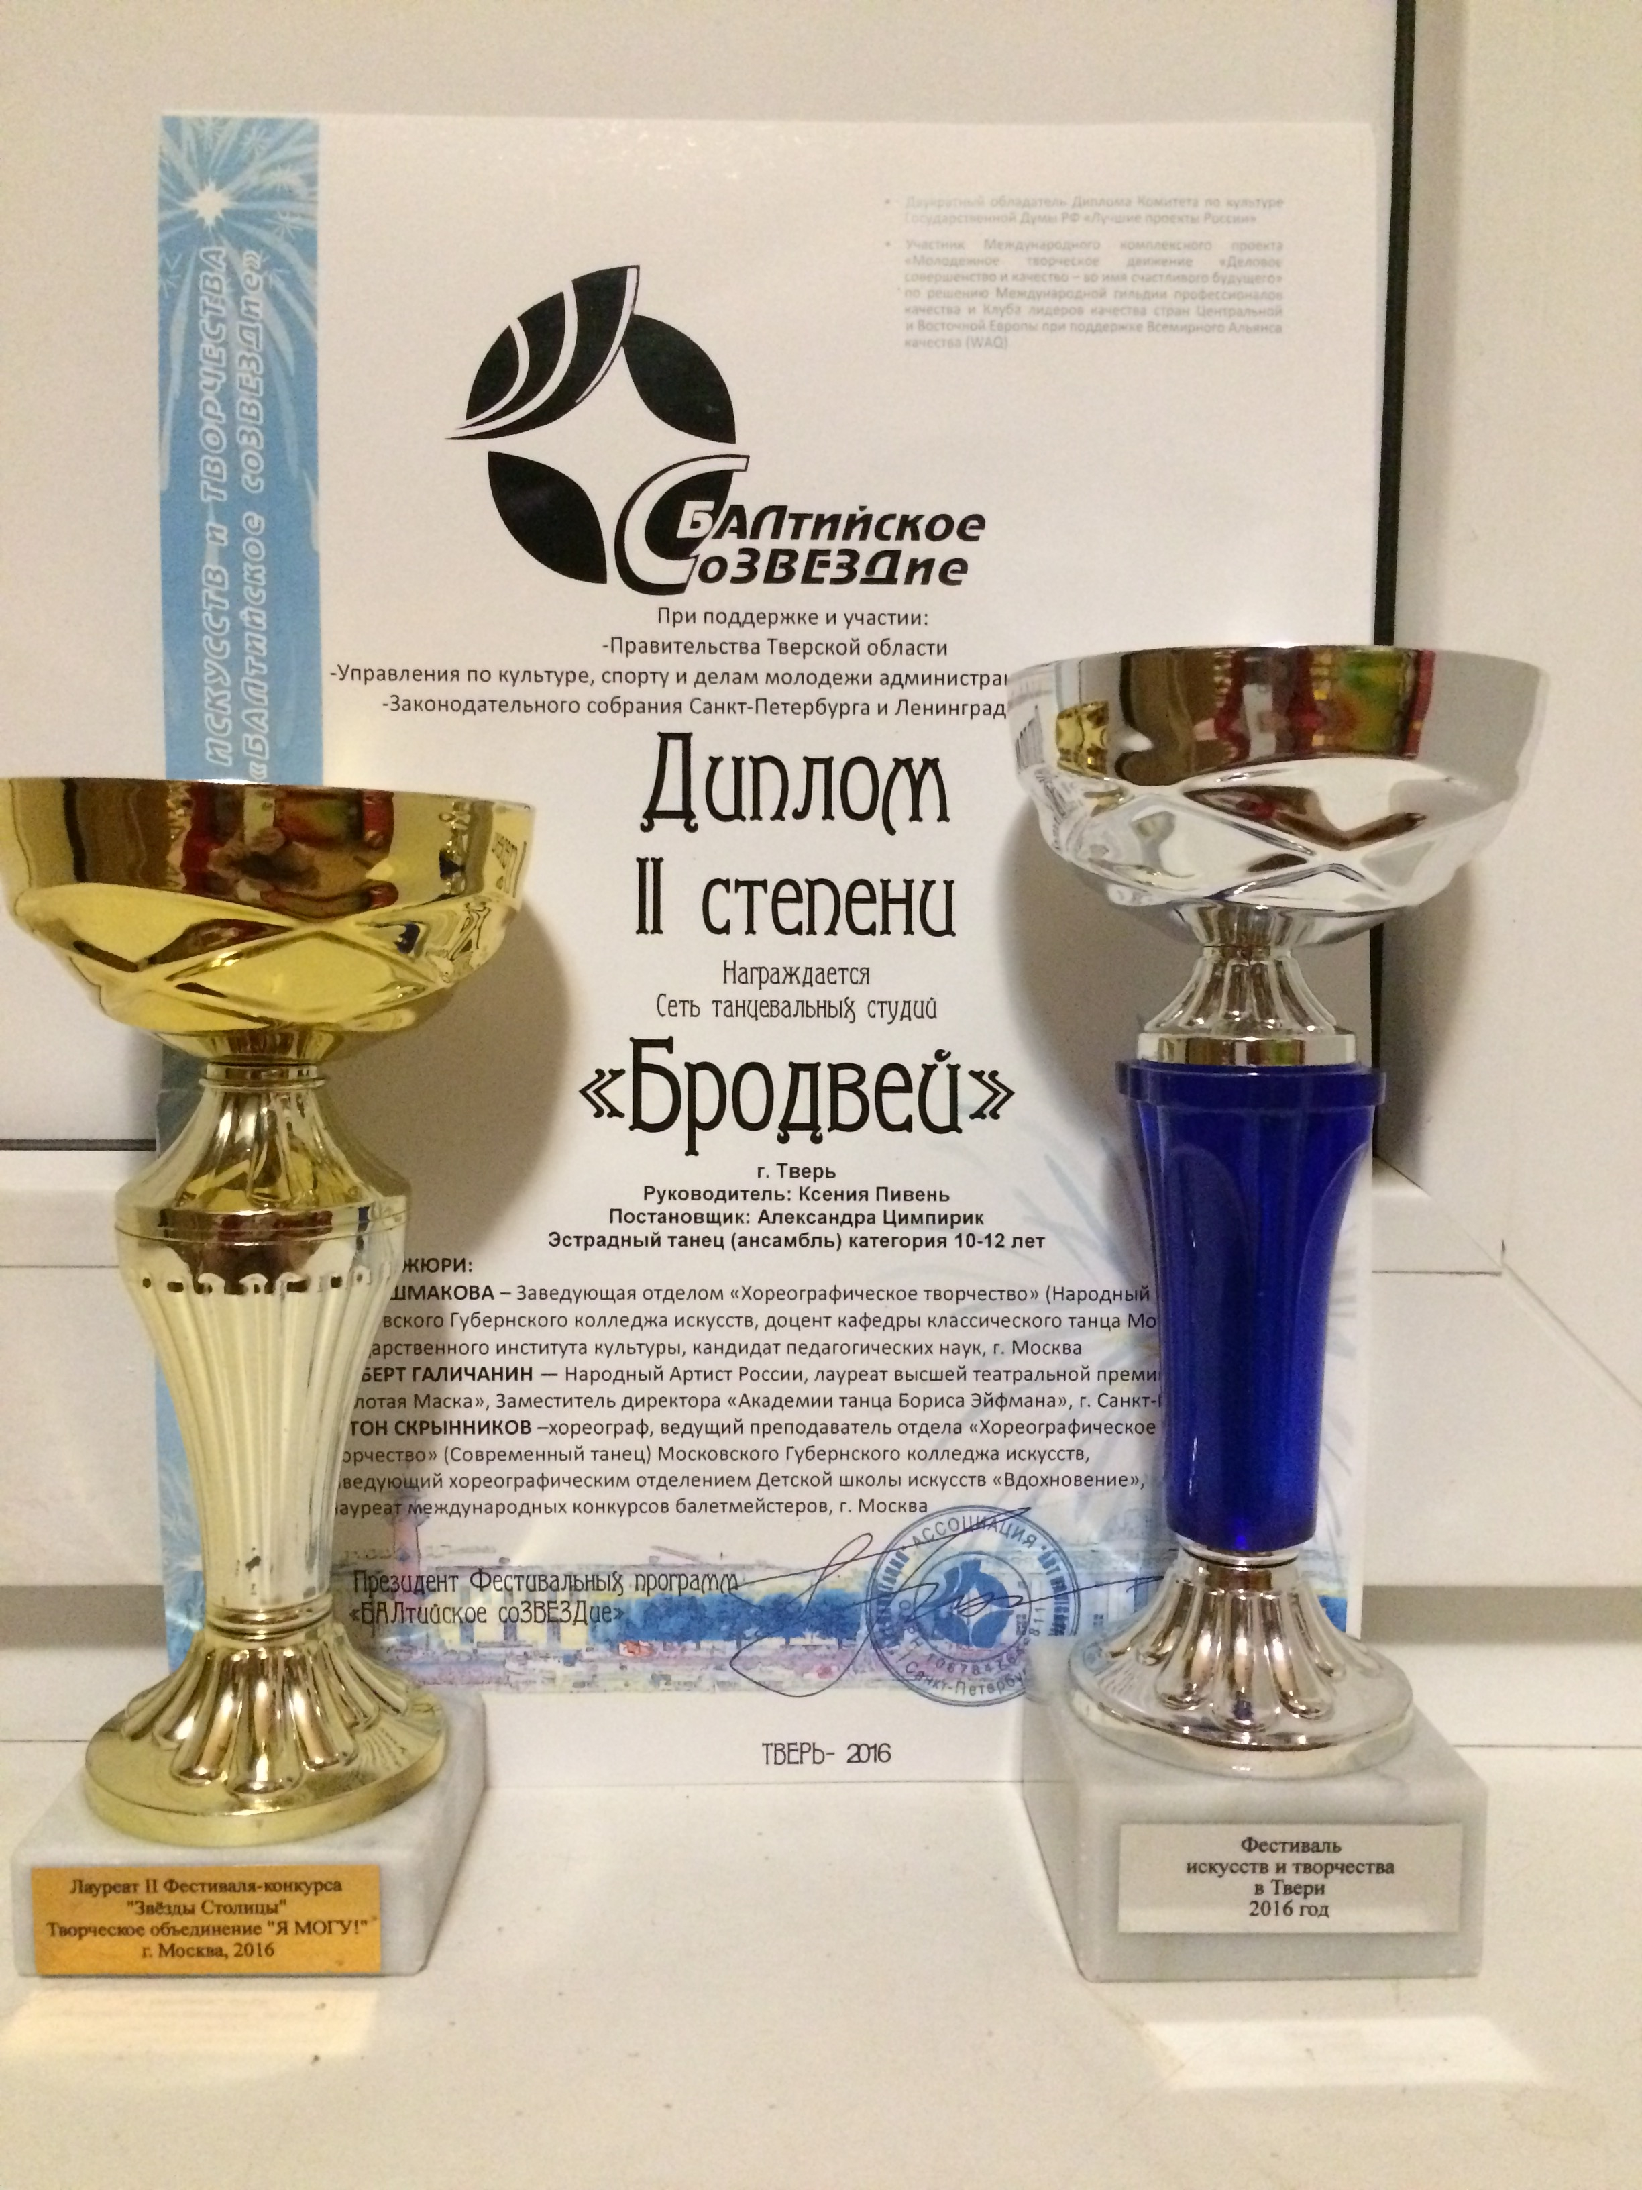
And I have another one hobby. It is dansing hip-hop. I have been doing it for half a year. I really like dancing.

Slide 4

Thank you for your attention

