Slide 1
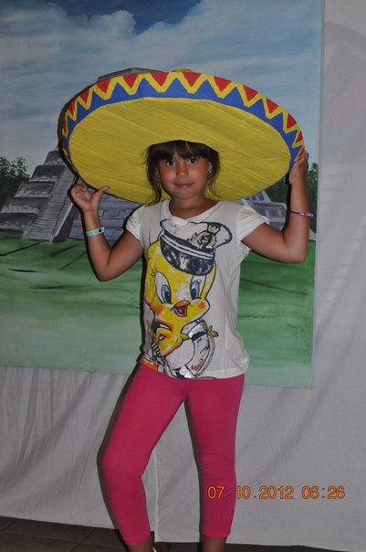
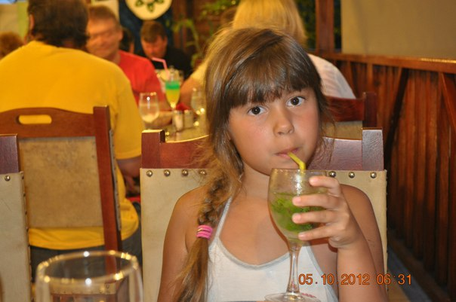
MY BEST FRIENDS
MY BEST FRIENDS DASHA. SHE IS NINE. SHE HAS GOT A MOTHER, A FATHER AND A SISTER. SHE LIKES PEORPLE AND BLUE. SHE LIKES PLAY WITH TEDDY BEAR. SHE COLLECTS DOLLS. SHE LOVES ROSES . SHE LIKES TO EAT FOR BREAKFAST SANDWICHES AND TEA. SHE IS MY BEST FRIENDS!

Slide 2
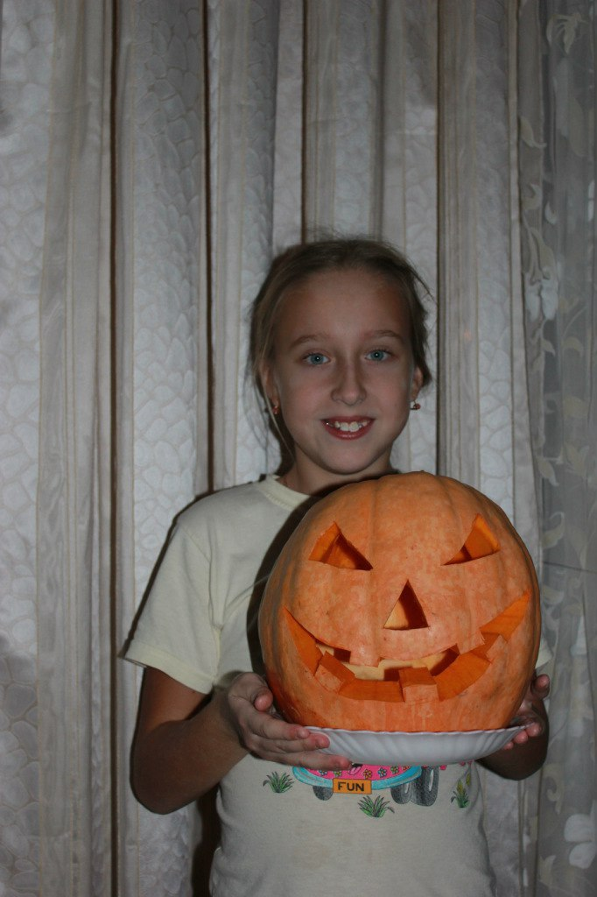
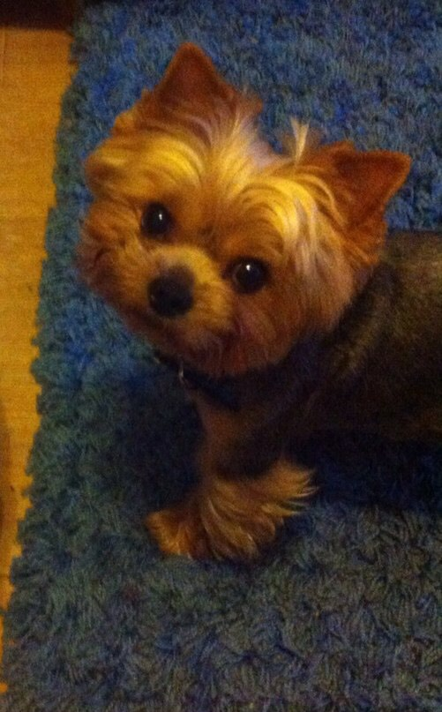
She has got a pet. Her name is Teodor. It is brown. He likes play with ball. He is not big. Dasha has got another friends. Their names are : Katya, Polyna, Sonya.

