Slide 1
Mini-project: We live on the same planet.
By the student: Mamedova Vefa , 7A
Teacher: Russkova N.A.

Slide 2
Questions

Slide 3
Questions №1
Can you describe yourself in five world ?
My answer :
I'm friendly, talkative , helpful , funny , creative and sometimes lazy .

Slide 4
Questions №2
What would you most like to change in yourself?
My answer :
I would like to be more athletic ,dress well, get along with my older brother and change the color of my hair .

Slide 5
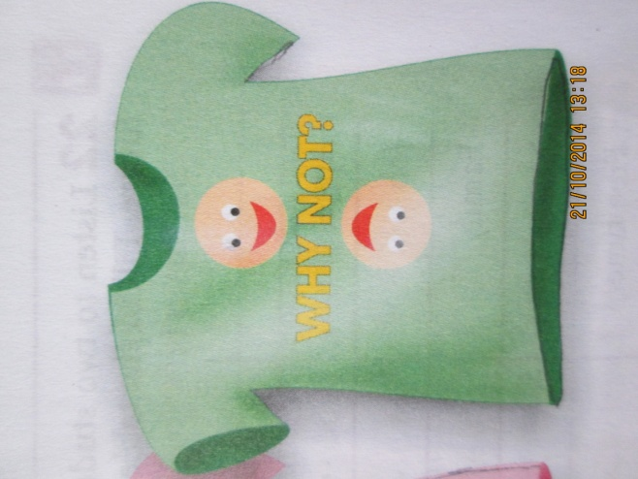
Questions №3
What's your motto?
My answer :
My motto is : " WHY NOT?"

Slide 6
Questions №4
How do you see yourself in 10 years time ?
My answer :
I do not know what I'll be there in 10 years, but I think I will be slim, beautiful and I have children.

Slide 7
Questions №5
How do you see our planet in 10 years ?
My answer :
I don’t care about the future. What’s point of thinking about it ? I’m young , I just want to go out with my friends and have a good time . I can’t change much in this world until I grow up.

